Slide 1


Matter in strong femtosecond laser fields: Strong field ionization, nanoplasmas, and high harmonic generation
Daniel D. Hickstein
Kapteyn–Murnane Group
JILA – University of Colorado
Notes:
Good morning, and thank you all for coming to my talk. My name is Dan Hickstein and I recently completed my PhD in the Kapteyn–Murnane group at JILA, where I am currently working as a postdoc. Today I’m going to describe a few different studies that I completed during my PhD, all of them different examples of matter in strong femtosecond laser fields. These studies range from the strong-field ionization of noble gas atoms, to plasma formation in nanoparticles, to the process of high harmonic generation. This illustration displays the basic photoelectron photoion spectroscopy experiment that is used in many of these studies, where a focused femtosecond laser interacts with a sample – in this case a gold nanoparticle stuck inside a dielectric nanoparticle – and ejects electrons or ions. These charged particles are then collected on this position sensitive detector.

Slide 2

Overview
Introduction
Femtosecond lasers and high harmonic generation (HHG)
Studies
Electron dynamics in strong laser fields
Photoelectron/photoion spectroscopy of nanoparticles and nanoplasmas
High harmonic generation with circularly polarized fields
Noncollinear circularly polarized HHG
Future directions
Notes:
Here is an overview of my talk. First, I’m going to provide a brief introduction about intense femtosecond lasers and the process of high harmonic generation. Next, I’m going to talk about four different studies of matter in strong femtosecond laser fields

Slide 3
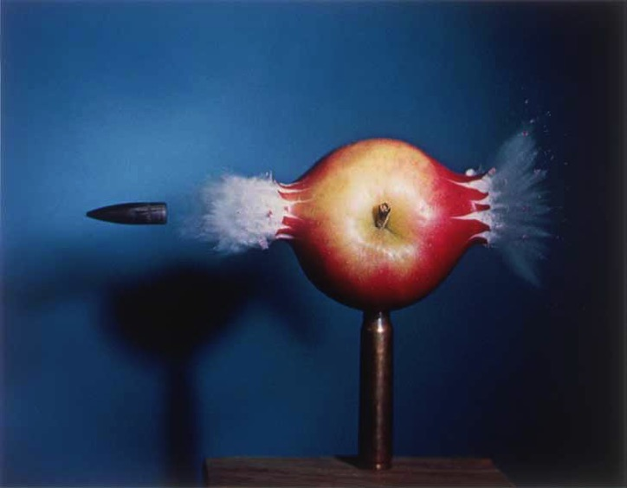
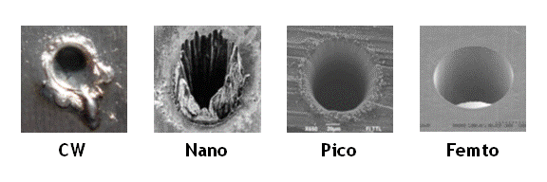
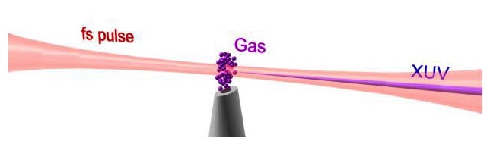
Femtosecond lasers
Short pulse duration
High intensity
Precision machining
In order to measure an event in time,
you need a shorter one.
High harmonic generation (HHG)
~1x10¹⁴ W/cm², ~1 mJ/pulse, ~1 kHz
Notes:
Perhaps the first question that I should answer is why we are interested in studying the interaction of matter with femtosecond lasers. And there are really two primary reasons that we are interested in femtosecond lasers. The first is maybe the most obvious: that femtosecond lasers can be used like a camera flash to study processes that occur on very fast timescales. And so, just as Harold Edgerton used a microsecond flashlamp to freeze the motion of bullets going through all kinds of objects, femtosecond lasers allow us to observe processes that are about 1 billion times faster. But more important for many applications is the incredibly high intensities that can be easily achieved when all of a lasers pulse energy is squeezed into a very short time duration. These high laser intensities allow material to be ablated without heating of the surrounding material, which makes femtosecond lasers ideal for precision machining. Most relevant to our research, the intense laser fields allow femtosecond pulses of visible or infrared light to be converted into even shorter pulses of extreme ultraviolet and soft X-ray light, simply by focusing the beam through a small volume of gas atoms.
Femtosecond machinng, high harmonic generation, and other interesting processes takes place when the laser field becomes strong enough to tunnel ionize atoms. This occurs at around 1e14 W/cm2, and this is the regime where most of the research in this talk, and indeed our entire field, takes place. This is easily achievable with pulse energies on the order of 1 mJ/pulse and reasonable focal length optics. With current commercial Ti:sapphire lasers, this means that we are running at a repetition rate of about 1 kHz.

Slide 4
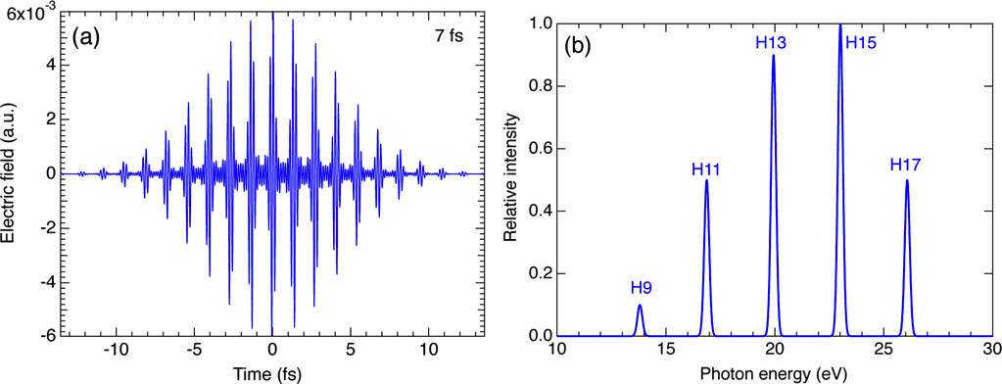
High harmonic generation (HHG)
Infrared photons
Extreme Ultraviolet (EUV) Photon
Notes:
The high harmonic generation process involves the simultaneous absorption of several infrared or visible photons from the driving laser and emitting a single EUV or soft X-ray photon. The harmonics produces are separated by twice the photon energy of the driving laser. The temporal structure of the harmonics is a attosecond pulse train, which consists of equally spaced attosecond bursts over the duration of the driving laser.
Recently, by using a 3.9 micron mid-infrared laser, our group was able to demonstrate high harmonic emission at photon energies higher than 1 keV. This corresponds to the absorption of over 4000 photons. The long term goal is to push this technique into the hard X-ray regime in order to have tabletop X-ray lasers.

Slide 5
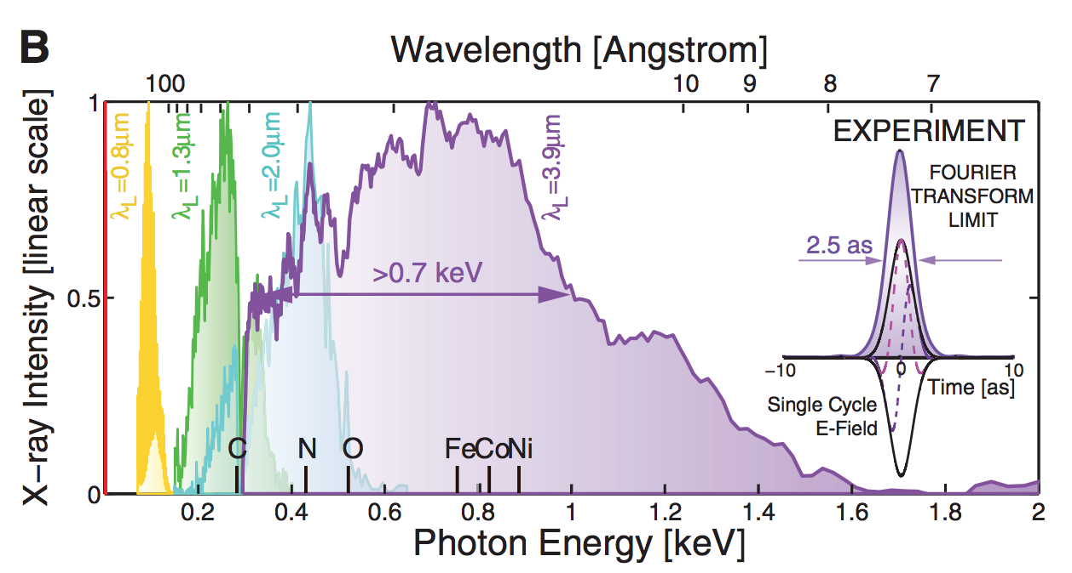
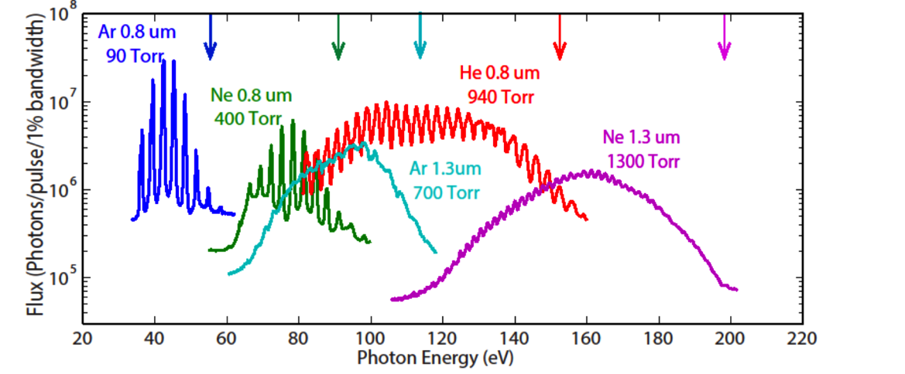
High harmonic generation (HHG)
Infrared photons
Extreme Ultraviolet (EUV) Photon
Notes:
As I’m showing here, we have some freedom to chose the energy range of the HHG process by changing the noble gas medium used for the HHG process or by changing the wavelength of the driving laser, with longer driving laser wavelengths cunterintuitively producing higher energy harmonics, but also with less conversion efficiency.
Recently, by using a 3.9 micron mid-infrared laser, our group was able to demonstrate high harmonic emission at photon energies higher than 1 keV. This corresponds to the absorption of over 4000 photons. The long term goal is to push this technique into the hard X-ray regime in order to have tabletop X-ray lasers.

Slide 6
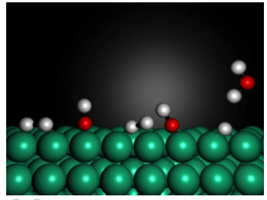
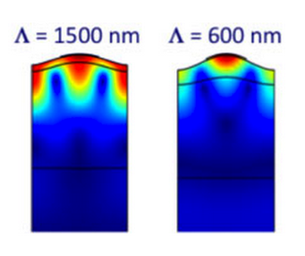

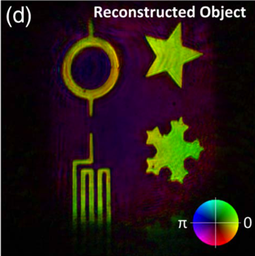

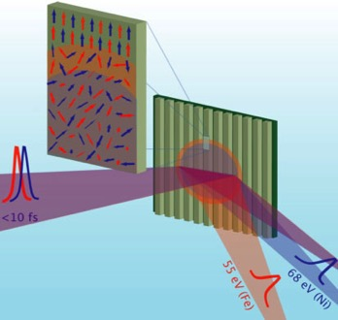
Ultrafast science in the KM Group
Ultrafast nanoscale
heat transport
Ultrafast surface science
High harmonic generation
Nanoscale coherent imaging
Ultrafast magnetic dynamics
KMLabs
Ti:sapphire CPA
(1-10 kHz)
Notes:
So, using both femtosecond lasers and the attosecond pulses obtained from HHG, the KM group here at JILA can study a wide assortment of the fastest processes that we can currently study. From studying dynamics at surfaces, to watching chemical reactions unfold, to looking at both heat transport and magnetic dynamics on a nanoscale, topics that have direct applications to constructing the next generations of CPUs and hard drives.
All of this is supported by our research into new methods of high harmonics generation. Which is in turn supported by Henry and Maragaret’s other project: a small company located in east boulder that manufactures some of the best Ti:sapphire chirped pulse amplifiers in the world.

Slide 7
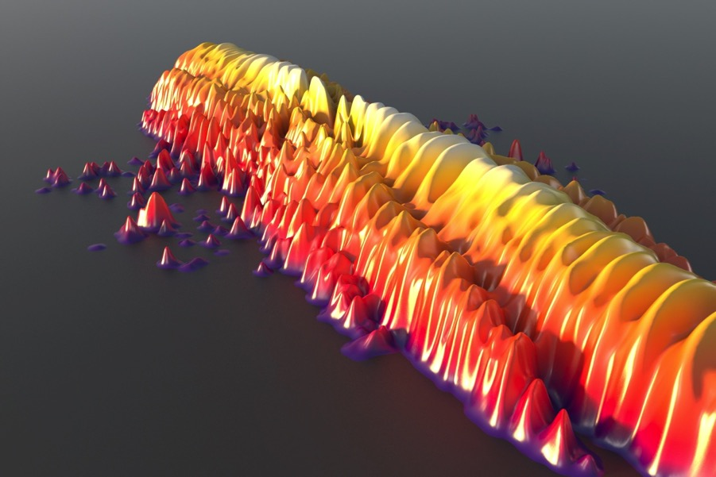
Study 1 Strong field ionization of atoms
D. D. Hickstein, P. Ranitovic, S. Witte, X.-M. Tong, Y. Huismans, P. Arpin, X. Zhou, K. E. Keister, C. Hogle, B. Zhang, C. Ding, P. Johnsson, N. Toshima, M. J. J. Vrakking, M. M. Murnane, and H. C. Kapteyn, “Direct Visualization of Laser-Driven Electron Multiple Scattering and Tunneling Distance in Strong-Field Ionization“
Phys. Rev. Lett. 109, 073004 (2012).
Notes:
The first study is of the strong field ionization of atoms in strong laser fields. It is based on a 2012 article published in Physical Review Letters. Specifically, we want to look at the dynamics of electrons that are ripped from these atoms by a strong laser field and then propagate in the combined laser field and Coulomb potential of the ion. As you can see from this illustration of the simulation results, this produces some very complicated and beautiful structures in the photoelectron distributions.

Slide 8
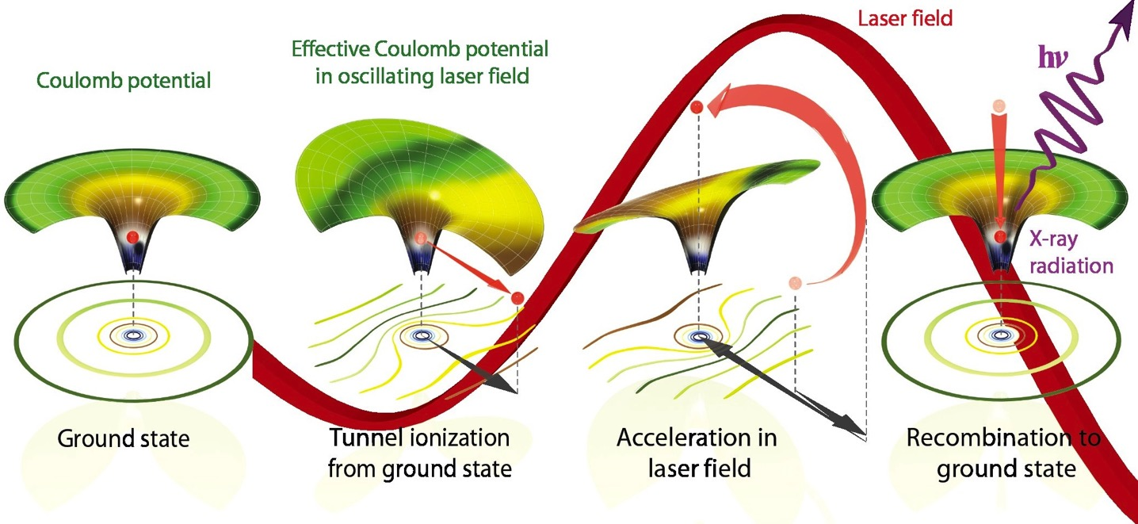
Three step model of high harmonic generation
STEP 1 STEP 2 STEP 3
Notes:
One of our main motivations for studying the ionization of atoms, is that the strong field ionization is closely related to the high harmonic generation process. We can understand this if we explain a little more about how high harmonic generation works.
If you want to get a complete picture of high harmonic generation, then the models can be extremely complicated. But, if you don’t mind making approximations, then we can model most of the key features of high harmonic generation using the three step model. And I think that it’s almost like a fairy tale.
So, we start off with the electron, living happily in the Coulomb potential. Oh no, but what is this, the laser field is so strong that it’s distorting the Coulomb potential, leaving only a thin barrier, though which the electron can tunnel through. So the electron tunnels out and starts rolling down this hill, away from its home.
But then there is a predictable twist: the laser field changes direction, and starts the push the electron back towards the Coulomb potential, picking up speed, going faster and faster.
Finally, the electron smashes back into the atom and releases its kinetic energy in the form of a high-energy photon.

Slide 9
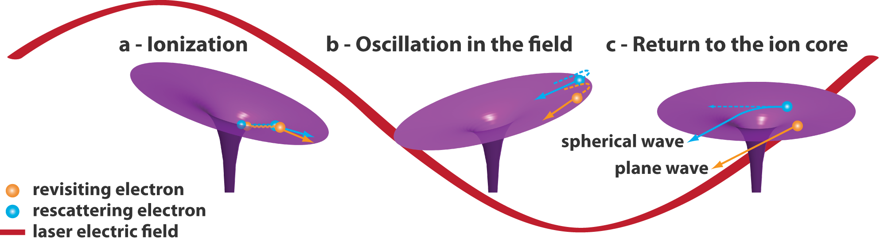
Strong-field ionization
Notes:
But, not all of the electrons that tunnel ionize will end up recombining with the ion. As you see here, the electrons can tunnel ionize, be accelerated in the laser field, and either completely miss the ion (as shown in orange) or just scatter off the ion without recombining.
This often-ignored process is called strong field ionization. Because it is the complementary process to HHG, we can learn a lot about HHG by studying SFI.

Slide 10
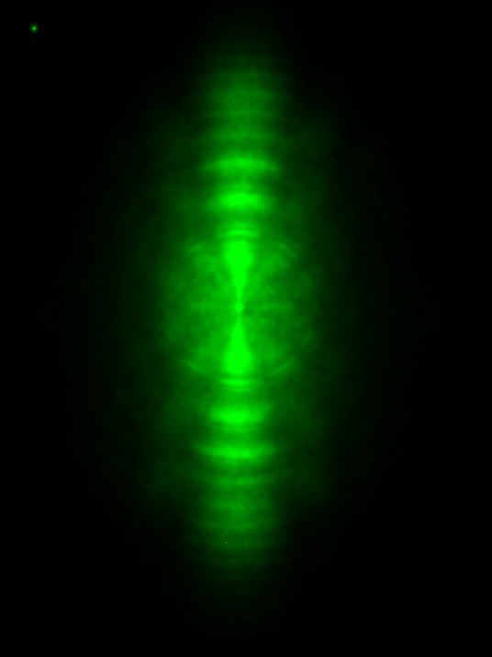
Velocity map imaging (VMI) spectroscopy
electrons/ions
Laser
atoms
(or nanoparticle)
Photoelectron momentum distribution
(+/-) Electric Field
Notes:
In order to look at the strong-field ionization of atoms in strong laser fields, we are going to use a technique known as velocity map imaging (or VMI) spectroscopy.
We start with a sample of atoms (or a nanoparticle, as I will talk about later).
The the laser pulse comes and hits the sample, kicking off electrons (or ions, but in this section I will be talking about electrons). These electrons can whiz off in all directions. The spectrometer has a detector on one side. An electric field pushed the electrons (or ions, depending on the polarity of the field) towards the detector.
The result is that the detector records a 2D projection of the full 3D momentum distribution of the electrons or ions.

Slide 11
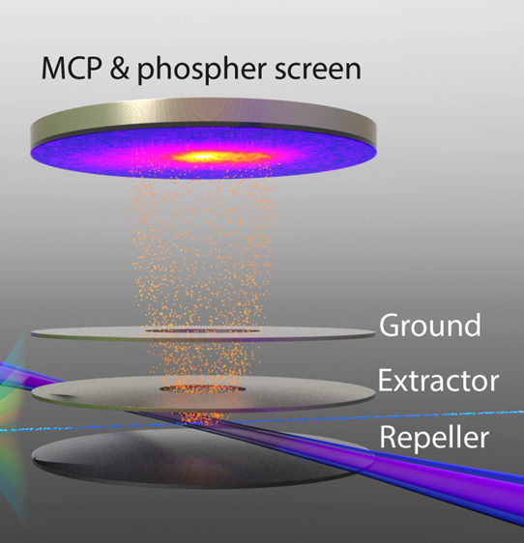
Velocity map imaging (VMI) spectroscopy
“Eppink and Parker” geometry
Notes:
Here is an illustration of what the apparatus looks like on the inside. Three electrodes are used to generate a static electric field which pushes the electrons onto the detector. And this geometry of the electrodes actually does something very special. As you can see here, the laser is fairly large, so we can create electrons throughout a large volume. This lens arrangement pushes the electrons in just such a way so that if two electrons have the same velocity, they arrive at the exact same point on the detector regardless of their initial momentum. This is why we call the device a velocity map imaging spectrometer, because it is only the velocity of the particle, not the initial position, that is mapped to the detector.

Slide 12

Apparatus
VMI Spectrometer
Notes:
This is what the apparatus looks like from the outside. It is about 1 meter long and consists of two differentially pumped vacuum chambers. Since this is a special occasion, let’s cut the chamber is half and see what is happening inside. As you can see, the nanoparticles emerge from the aerodynamic lens and pass into the VMI spectrometer. The laser creates a plasma from a single nanoparticle and the positive ions are pushed towards the detector.

Slide 13
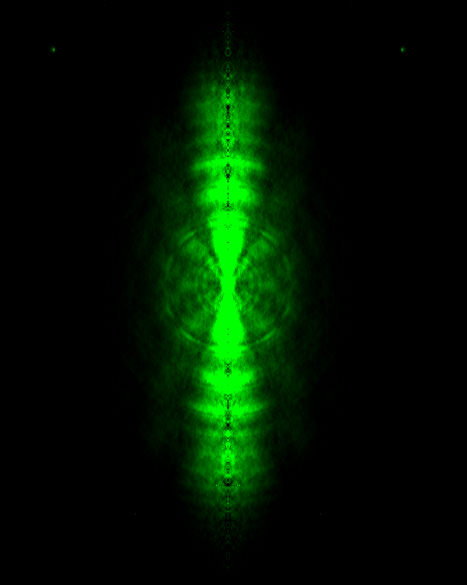
2D to 3D
2D
Slice of 3D
P_{x}
P_{x}
P_{z}
Math
(Abel transform)
P_{r}
N₂ - 800 nm
2D projection, as recorded on VMI
Abel transform with BASEX (assumes cylindrical symmetry)
Notes:
Since we are just using an electric field to squash the electrons onto the detector, we get a 2D projection of the 3D momentum distribution. This tends to blur the features that we want to look at. What we really want is the 3D momentum distribution. In most VMI experiments, the photoelectron distribution is cylindrically symmetric about the laser polarization axis. Because of this symmetry, we can use the Abel transform to obtain the 3D distribution from the 2D projection.
And this is what the photoelectron angular distributions looks like from the strong-field ionization of nitrogen at 800 nm.

Slide 14
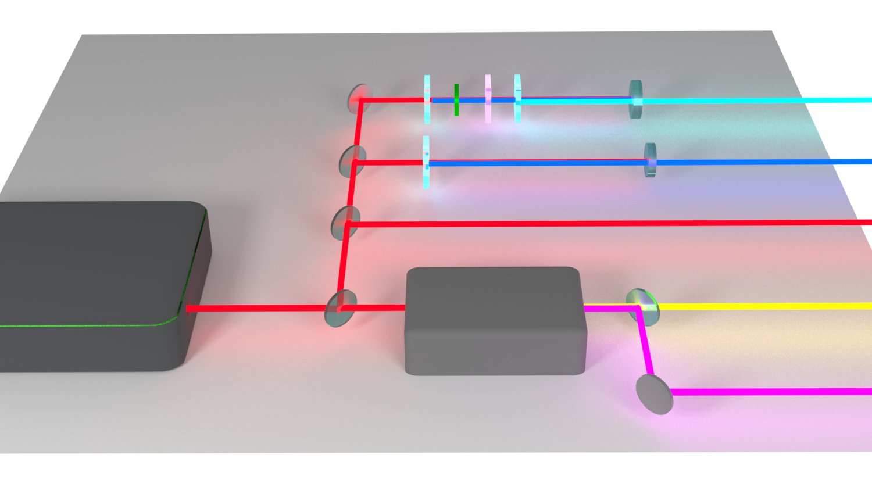
Light sources
BBO λ/2 calcite BBO
267 nm
BBO
400 nm
Ti:sapphire
laser
800 nm
OPA
1300 nm
2000 nm
Notes:
So, people have looked at the strong-field ionization from atomic gases before. What makes our experiment different from the rest is that we use a broad range of different wavelengths, which allows us to see how the physics changes as a function of wavelength. This is a knob that previous studies could not turn as far as we could. The reason this had not been done before is that it’s reasonably difficult. We cannot just turn a knob and tune our laser across a broad range of wavelengths, we need to implement complicated frequency conversion steps using nonlinear optics. And this means that we needed to start with a fairly powerful femtosecond laser.
The 800 nm light is easy, because that is the direct output of the Ti:sapphire laser system. The second harmonic at 400 nm is also pretty easy, because all you need to do is stick a beta barium borate or BBO crystal into the beam and produce 400 nm light.
The 267 nm light is a little more difficult, because you need to produce 400 using a BBO crystal, use a half waveplate to correct the polarization, a calcite plate to set the appropriate time delay, and then generate the third harmonic in a second BBO crystal through sum frequency generation.
The 1300 and 2000 nm wavelengths are the most difficult to generate. To make these, we use a three-stage optical parametric amplifier. As far as I am concerned, this is just a black box that magically makes mid-infrared wavelengths.

Slide 15
Experimental photoelectron distributions
Keldysh
Parameter:
3
2
1
0.6
0.4
Notes:
So, here is what the photoelectron spectra look like under strong-field ionization using these different driving laser wavelengths. One of the first things that we notice are that some of these spectra have very sharp rings. These first ring corresponds to enough photons to give the electron enough energy to overcome the ionization potential of the atom. The outer rings correspond to the absorption of additional photons over the ionization potential. This process is called above-threshold ionization.
As we make the wavelength longer, we notice that the rings disappear, and the electron distribution becomes more elongated. And this is due to the fact that on the left, we have a high keldysh parameter, which means that we are will into the multiphoton regime, while on the right we have a low keldysh parameter, indicating that we are in the tunneling regime.
The other interesting things that we see are these pronounced side-lobe structures for the 800, 1300 and 2000 nm spectra. We called these the “spider” structures, because in some cases, especially here at 1300 nm, they look like the body and legs of a spider. Some previous studies had speculated that these structures were a result of the scattering of the electron wavepacket from the Coulomb potential of the ion. We were able to confirm this explanation by developing a simple model that could predict the shape and spacing of these spider structures just based on simple electron trajectories that scatter symmetrically from the ion.

Slide 16
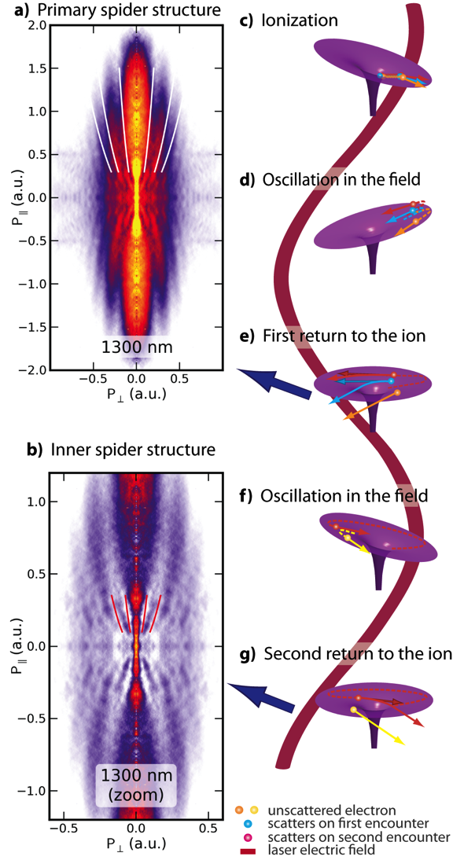
Notes:
But, since we used different wavelengths than previous studies, we were able to make an additional observation. Not only is there a large spider structure at higher final electron momentum, but there is also an “inner spider structure” at lower electron energy.
We speculated that since the primary spider structure is due to the electron wavepacket scattering from the coulomb potential on it’s first pass, it’s possbile that the inner spider structure corresponds to the electron wavepacket scattering on the second pass. And this explanation was confirmed by our simple model, which accurately predicted the spacing of the inner spider structure when we modified the model to account for higher order rescattering of the electron wavepacket.

Slide 17
High-order recattering
Notes:
A simple analysis of the field-driven electron trajectories indicates that there should be clear cutoffs in the final momentum that correspond to different numbers of times that the electron can be driven past the ion, and that this should depend on the wavelength and intensity of the driving laser. And this is exactly what we see in the data. The inner spider structure has a pretty clear outer cutoff here.

Slide 18
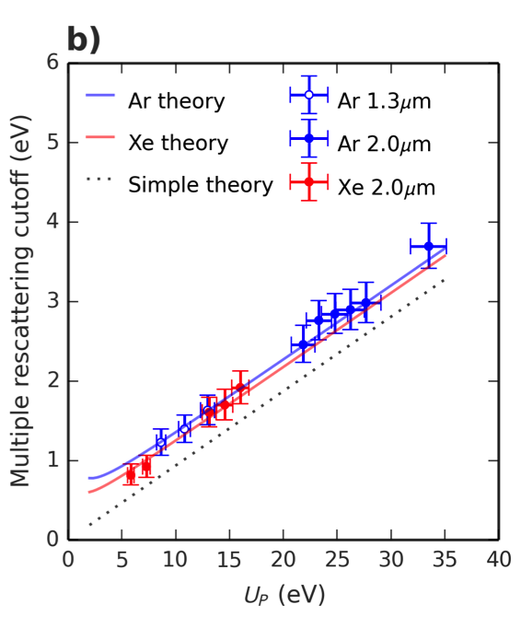
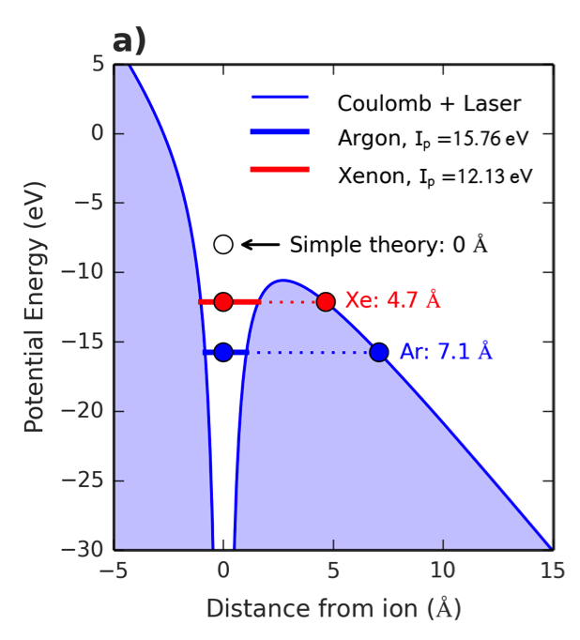
Measurement of tunnel distance
Notes:
But, when we compare the experimental cutoffs (given by these dots with error bars) to what is predicted by our model (shown as a dotted black line), then we see that there is a problem, they don’t line up!
However, our model forgot about something, we did not take into consideration the fact that when the electron tunnels from the atom, it emerges at a small distance from the atom. Here is a sketch of that process. As you can see, the real tunneling distance is only a few angstrom. But, when we take that small tunneling distance into consideration in the model, we find that we actually have very good agreement with the experimentally observed cutoffs.
As far as we know, this is perhaps the only observation of the tunneling distance that takes place when atoms experience a strong laser field.
And I would not claim that we are making a very accurate measurement of the tunnel distance. As you can see from the error bars here, we can tell that there is a nonzero tunnel distance, but we don’t actually measure it much better than that.

Slide 19
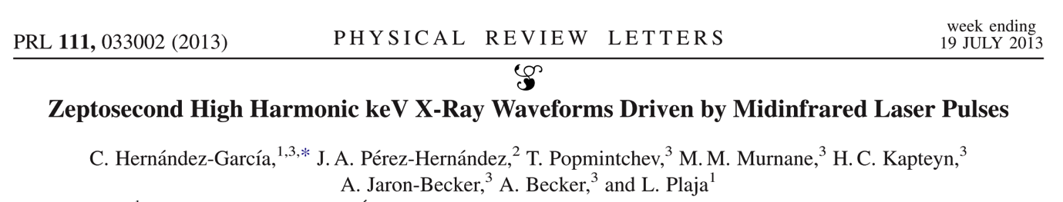
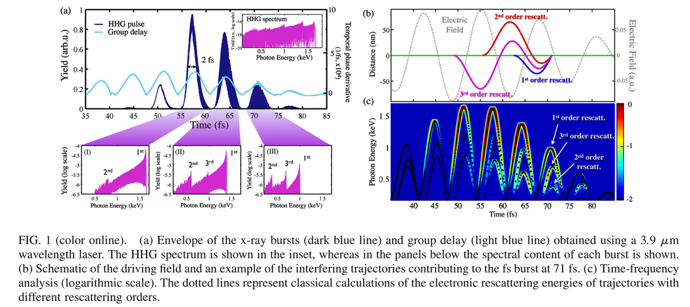
Zeptosecond pulses
Notes:
So, when we published this study, I thought that it was interesting, but I thought that there was really a zero percent chance that the rest of the world would ever really care about the fact that an electric field could wiggle atoms past a xenon atoms multiple times. That seems like a really small detail. However, a more recent paper written by Carlos from Andreas Becker’s group presented theoretical calculations demonstrating how the interference of the different high-order rescattering trajectories could enable the generation of pulses with zeptosecond structure. So, it’s possible that this technique could be used to set a new record for the world’s shortest laser pulses.

Slide 20
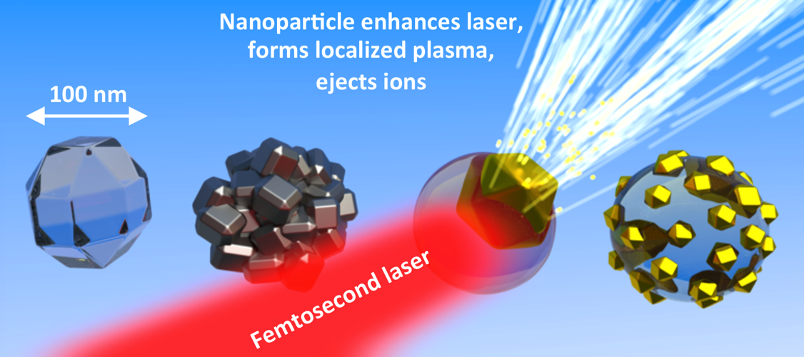
Study 2 Nanoparticles and nanoplasmas
1. D. D. Hickstein. et al. Mapping Nanoscale Absorption of Femtosecond Laser Pulses Using Plasma Explosion Imaging. ACS Nano 8, 8810 (2014).
2. D. D. Hickstein et al. Observation and Control of Shock Waves in Individual Nanoplasmas. Phys. Rev. Lett. 112, 115004 (2014).
3. W. Xiong, D. D. Hickstein, et al. Photoelectron Spectroscopy of CdSe Nanocrystals in the Gas Phase: A Direct Measure of the Evanescent Electron Wave Function of Quantum Dots. Nano Lett. 13, 2924 (2013).
4. J. L. Ellis, D. D. Hickstein, et al. Solvents Effects on Charge Transfer from Quantum Dots. J. Am. Chem. Soc. 137, 3759 (2015)
Notes:
In the next part of this talk, I’m going to describe another study with the VMI spectrometer, but this time I’m presenting some of the first examples of nanoparticles being studied with this spectrometer. This project has published several different papers, but I’m going to focus on these first two, which describe results using high-intensity lasers. And I’ll just briefly talk about some of our results studying quantum dots at lower laser intensities.

Slide 21

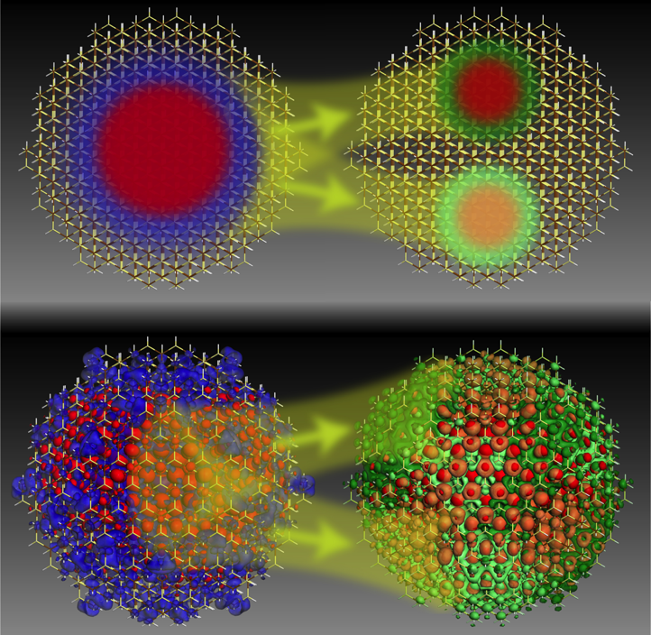
Nanoparticles in the VMI
Zewail group
Mark Lusk, Colorado School of Mines
Electronic structure of
quantum dots (semiconductor nanocrystals)
Velocity Map Imaging Spectroscopy (VMI)
Notes:
So how did we get involved in this difficult and very messy business of putting nanoparticles into our VMI spectrometer?
Here I’m showing two journal covers. This cover on the left is from the Zewail group and is a nice demonstration of how VMI images like these can provide beautifully detailed information about the electronic structure of a molecule in the gas phase. With these cartoons, they are showing how the experimental images at various time delays can be stitched together to provide a femtosecond movie of a chemical reaction.
On the right I’m showing an ACS nano cover from the Lusk group that shows a calculation of excitonic wavefunctions in quantum dots. Our overarching goal is to use velocity map imaging to try to obtain similarly detailed images and movies of nanomaterials just like it has done for atoms and molecules in the gas phase.

Slide 22
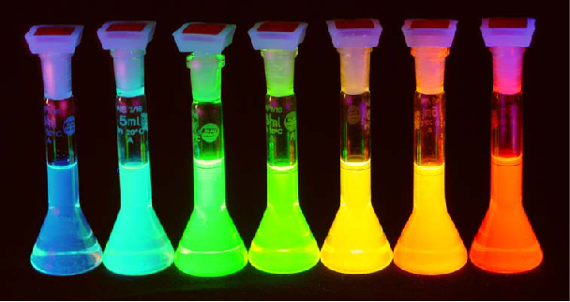



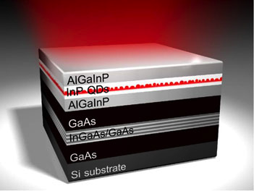
Nanoparticles in vacuum
University of Colorado Chemistry Department
Brett Palm
Jose Jimenez
Notes:
As you may know, nanoparticles are typically found imbedded in bulk material, attached to a surface, or, most commonly, swimming in a large container of solvent. This is not ideal, because whenever you study them when they are in close proximity to something else, it’s never clear if you are studying the fundamantal properties of the nanoparticles, or if you are studying the interaction of the nanoparticles with the solvent. Also, if the particles are stuck in a jug of solvent or buried in a brick of material, we cannot use photoelectron or photoion spectroscopy.
So, how did we go about getting them into our ultrahigh vacuum chamber? Well, we were lucky enough to be located just down the block from the Jose Jimenez group at the University of Colorado Chemistry Department. Jose and his lab spend their time flying around in airplanes sucking atmospheric dust into their mass spectrometers. So, these people are truly professionals at getting nanoparticles into vacuum chambers. They were nice enough to show us the equipment that they use and how it works. So, as soon as their back was turned, we “borrowed” that equipment and attached it to our spectrometer.

Slide 23
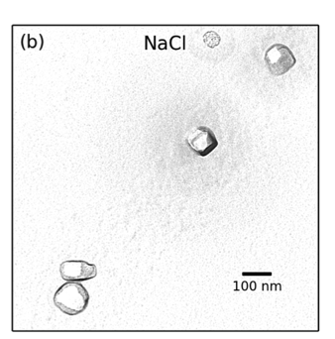
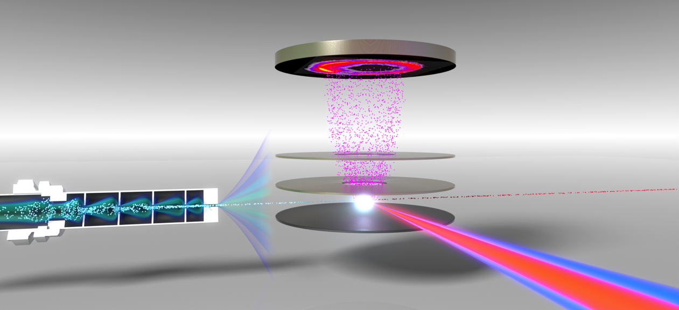

Experiment
VMI spectrometer + aerodynamic lens
Detector
Positive ions
Aerodynamic lens
VMI Electrodes
400 nm and 800 nm
laser pulses
(40 fs, 1 kHz)
Nanoparticle beam
Plasma explosion from single nanoparticle
atomizer
Notes:
This figure shows our VMI spectrometer, modified to incorporate a nanoparticle source. The source consists of a compressed gas atomizer and an aerodynamic lens. We start with 1 liter bottle containing either colloidal nanoparticles or simply a salt solution. The atomizer produces a fine mist of 1 micron droplets which evaporate to leave behind nanoparticles with diameters of about 100 nm. These particles consist of either aggregates of nanoparticles or single crystals of salt. The nanoparticle aerosol then passes through the aerodynamic lens, which forms a collimated beam of nanoparticles while leaving the gas divergent. The nanoparticle beam is then crossed with a femtosecond laser operating at 1 kHz. The positive ions that are released are collected by a velocity-map-imaging spectrometer.
The most interesting part of this experiment is that we can control the number of nanoparticles in the interaction region simply by changing the spot size of the laser. In the experiments that I will talk about today, we use a very small laser which allows us to probe single nanoparticles.

Slide 24
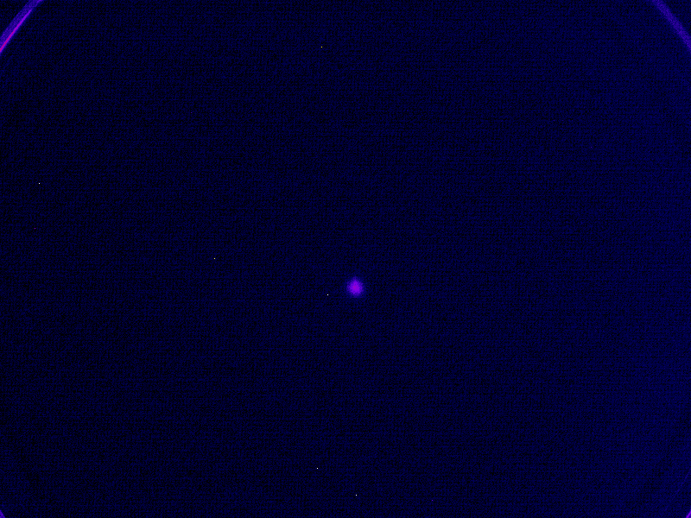
Ion distributions of single nanoparticles
Display asymmetry
Laser polarization
Laser propagation
Notes:
We were originally trying to just ionize a few electrons from the nanoparticles, but, we accidentally had the laser tuned up way too high, and here is what we saw.
Here is a slightly more colorful view of what the raw data looks like on the detector. You can see sudden flashes that contain on the order of 10,000 or more ions. These flashes correspond to the conversion of a nanoparticle into a nanoplasma, which rapidly expands and showers the detector with positive ions.
You will notice that there is a lot of variability of the photoion yield and the shape of the photoion angular distribution. This is because, the nanoparticles have a distribution of shapes and sizes and this influences the photoion distribution.

Slide 25
Asymmetry in ion distributions
Depends on laser intensity
Notes:
Here is another sketch of the experiment.
This asymmetry depends on the intensity of the laser. When the laser intensity is high, we see ion momentum distributions that are more-or-less symmetric about zero kinetic energy and correspond to the creation of a plasma in the entire nanoparticle. However, when we use lower laser intensities, we see ion distributions that are highly asymmetric and correspond to the formation of a localized plasma in a small region of the nanoparticle.

Slide 26
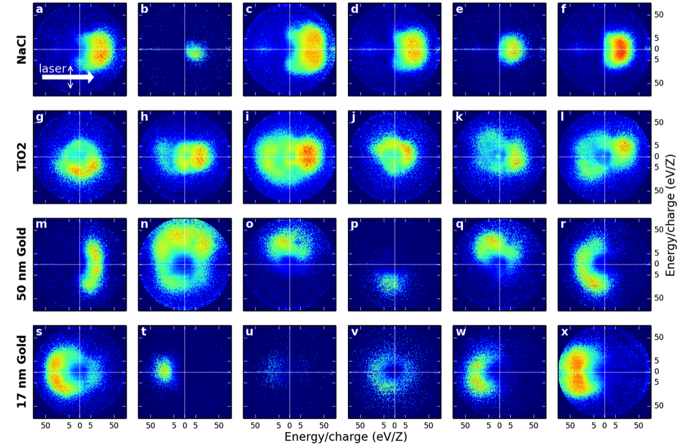
Asymmetric ion distributions
Depends on sample composition
Notes:
We also noticed that the asymmetry of the ion distribution depends on which nanoparticle sample that we use.
a) As you can see, the NaCl sample ejects ions in the direction of laser propagation. This is very unusual for VMI, because the angular distributions are almost always cylindrically symmetric about the laser polarization direction.
b) The TiO2 ejects ions symmetrically about zero kinetic energy. c) 50 nm gold nanoparticles shoot ions in seemingly random directions: up, down, left, right, wherever! D) The 17 nm sample ejects ions back towards the source of the radiation.
But what is causing these different behaviors? We struggled with this question for a long time, until we finally had the simple idea of actually looking at the nanoparticles that we were probing.

Slide 27
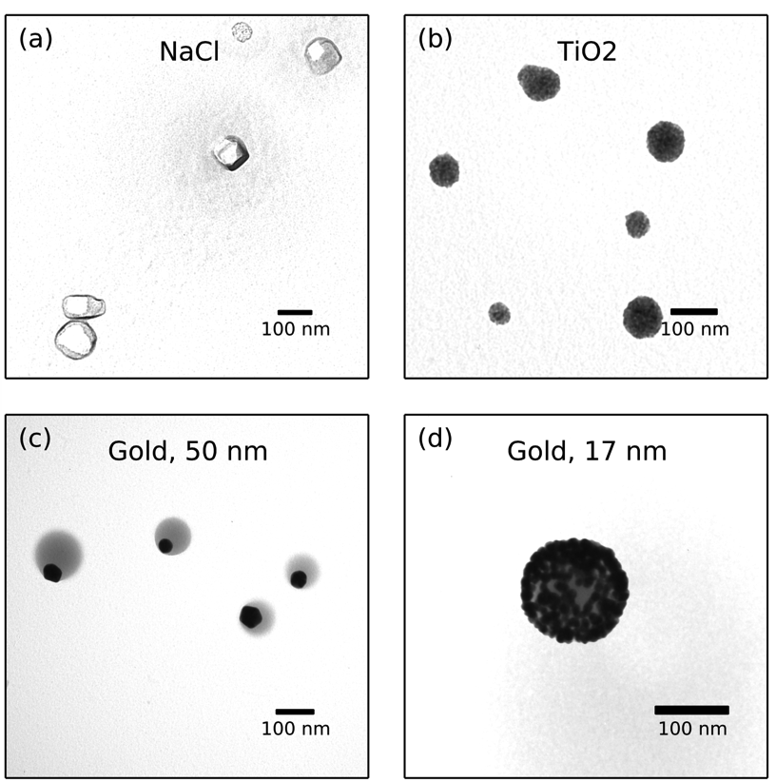
Electron microscopy
Reveals particle morphology
Notes:
The key to figuring out this sample dependence was to place TEM grids inside of the vacuum chamber and collect nanoparticles as they fly through the experiment. Then we can perform electron microscopy and see what are particles actually look like. A) A sodium chloride solution produces 100 nm particles that appear to be single crystals. B) the TiO2 solution produces aggregates of 5 nm TiO2 particles. C) The 50 nm gold sample produces very weird looking “nano eyeballs” that feature a gold nanoparticle, shown here in black, embedded in a sphere of lower density material. The lower density material is an organic polymer that that manufacturer of the nanoparticles puts in the solution to keep the particles from aggregating, and here it has the unexpected but convenient effect of allowing us to produce asymmetric nanoparticles. D) the 17 nm gold nanoparticle sample is also composed of a large sphere of ligand polymer material, but in this case, we have many small gold nanospheres per aggregate.

Slide 28
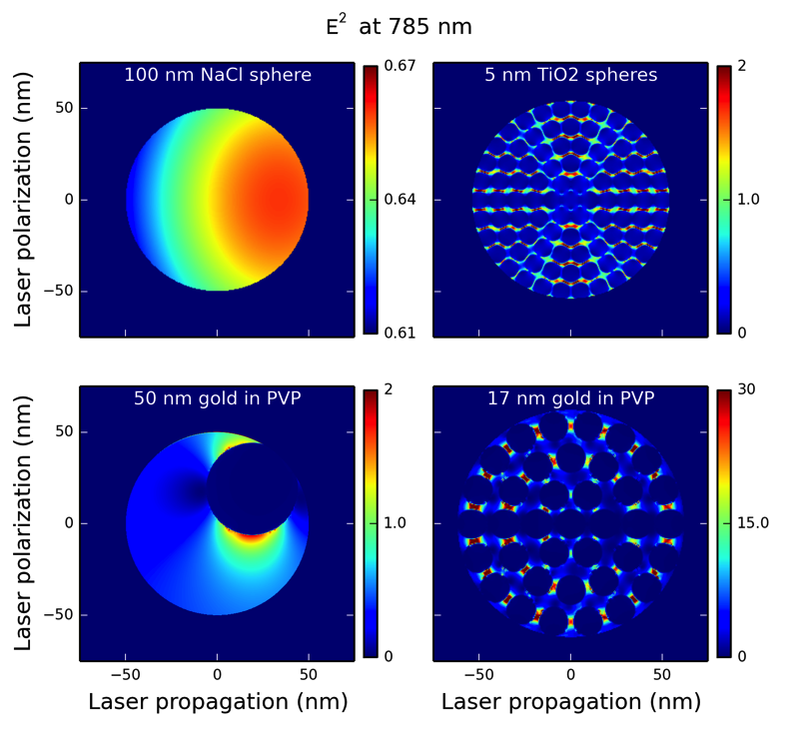
FDTD simulations
Explain light absorption
Notes:
Armed with this information about the morphology of the nanostructures, we used finite-difference time-domain simulations to explain the light absorption behavior of the nanoparticles. These simulations can figure out how intense the light field will be in each of these particles. In all cases, the nanoparticle can enhance the laser field.
In each case, the location of the strongest electric field agrees with the experimentally observed direction of ion ejection. A) for NaCl, the light is enhanced on the backside of the particle, and it seems that the particle is basically acting like a lens and focusing the light onto itself. B) For the TiO2 aggregates, the light is enhanced between the TiO2 particles, but there is not preference for the forward or backward direction. C) For the 50 nm gold nanoparticles, there is not a big effect from the laser polarization or propagation. The electric field is simply strongest near the gold nanoparticle and so a plasma will be formed in this region of the particle preferentially. D) For the 17 nm gold nanoparticles, the field is enhanced by an order of magnitude between the gold nanoparticles. If you look very closely, you can see that the field is higher here on the front side of the particle, in agreement with the experimental results.

Slide 29
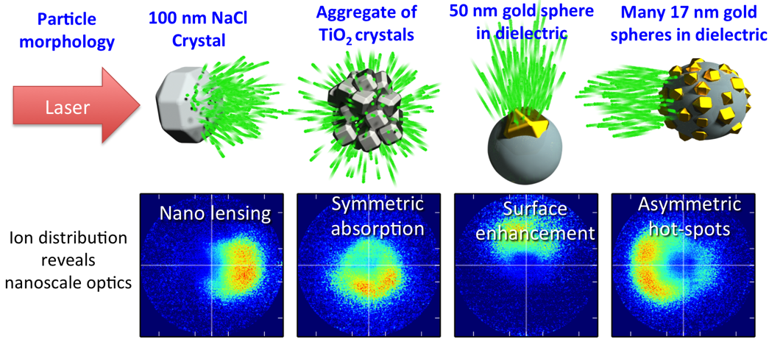
Summary
Ion angular distributions reveal nanoscale optics
Other particle morphologies?
Notes:
To summarize this section, we have observed very different ion ejection from these four different nanoparticle samples, and we have explained how the direction of ion ejection is representative of the nano-optical effects in the particles. This is, to our knowledge, the first example where we can measure the directional absorption of strong femtosecond laser pulses at a high repetition rate.
While the behavior of all of the samples that we have investigated so far could be explained through simple FDTD simulations, it’s possible that in the future this method can be used to provide direct experimental insight into nanoscale systems that cannot be explained by theory.

Slide 30
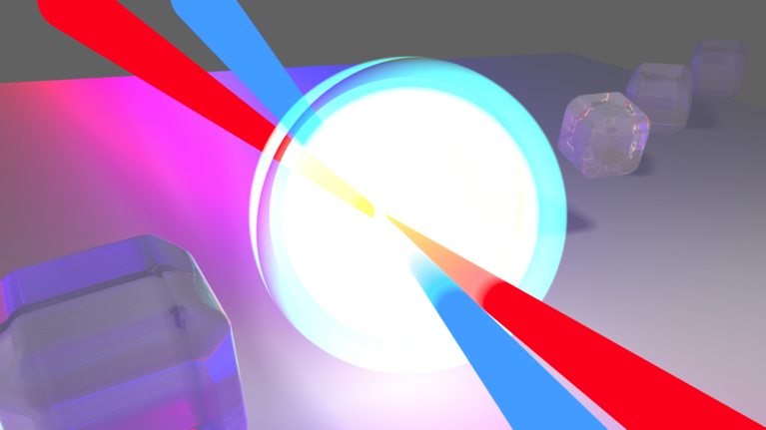
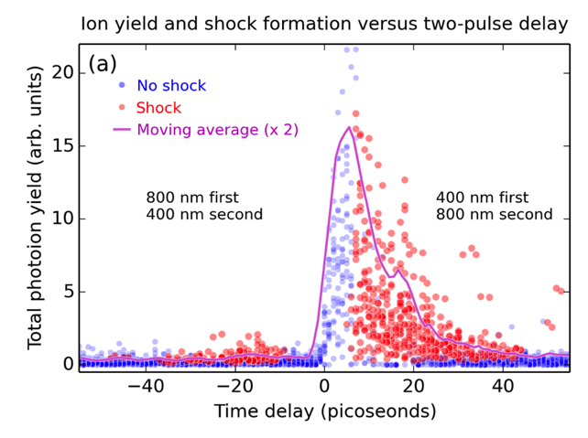
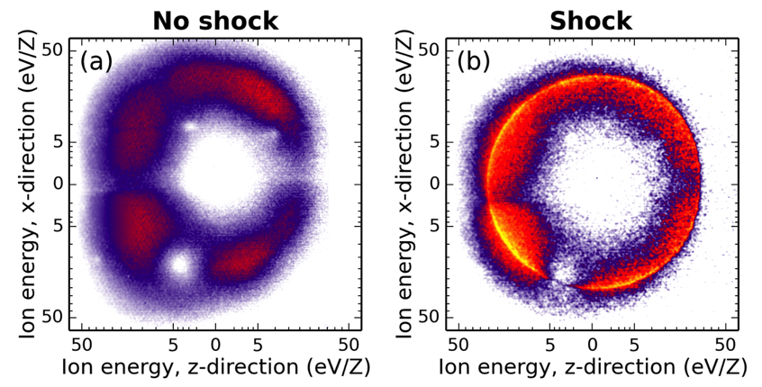
Study 2b Shock waves in nanoplasmas
D. D. Hickstein et al. Observation and Control of Shock Waves in Individual Nanoplasmas. Phys. Rev. Lett. 112, 115004 (2014).
Notes:
As another example of the power of this type of spectroscopy, I have a one slide summary of another study that we used two laser pulses: one to convert a nanoparticle into an expanding nanoscale plasma. If we adjusted the time delay to about 10 picoseconds, we could create these pronounced ridges in the photoion angular distributions. After we looked at the time-dependence of this feature and completed some numerical modeling in collaboration with Lawrence Livermore National Lab, we came to the conclusion that these ridges were shock waves propagating in the nanoplasma.
The time-dependence of the features corresponds to the plasma expanding to an ideal size and density to promote maximum absorption of the second laser pulse.

Slide 31
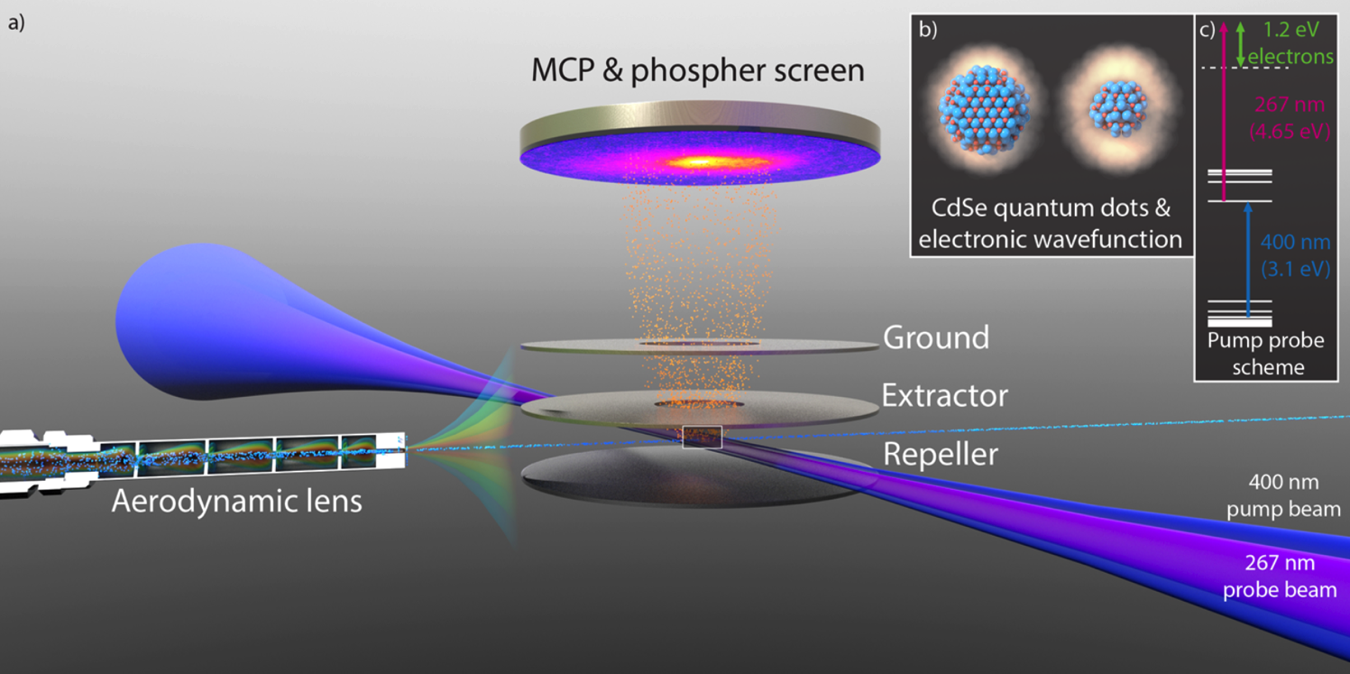
Study 2c Evanescent exciton in quantum dots
W. Xiong, D. D. Hickstein, et al. Photoelectron Spectroscopy of CdSe Nanocrystals in the Gas Phase: A Direct Measure of the Evanescent Electron Wave Function of Quantum Dots. Nano Lett. 13, 2924 (2013).
Notes:
And, true to our original mission for the project, we were able to study the photoelectrons from quantum dots. We were able to excite a 1S exciton state with a 400 nm pump beam and subsequently bring the electron into the continuum using a 267 nm pulse. Unexpectedly, smaller quantum dots provided a much larger photoelectron yield than larger quantum dots. At first, we thought this was some experimental artifact, like that there were simply more of the smaller quantum dots in the spectrometer. But even after we corrected for this, we still found that the smaller quantum dots provided more photoelectron yield.
Working with surface photoemission experts, and quantum dot experts in the Chemistry Department at CU, we came to the conclusion that it is ionization from the small fraction of the electron wavefunction that extends outside of the quantum dots that plays the dominant role in the total photoelectron yield. Smaller quantum dots have a larger fraction of their electronic wavefunction that extends outside of the quantum dot, and so they provide a much higher photoemission rate.

Slide 32
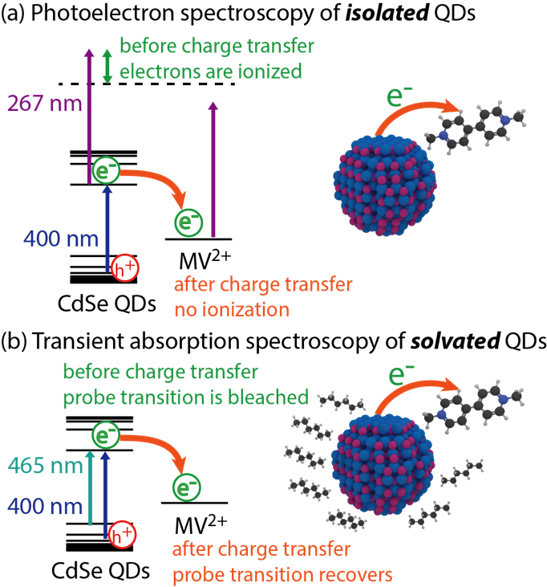
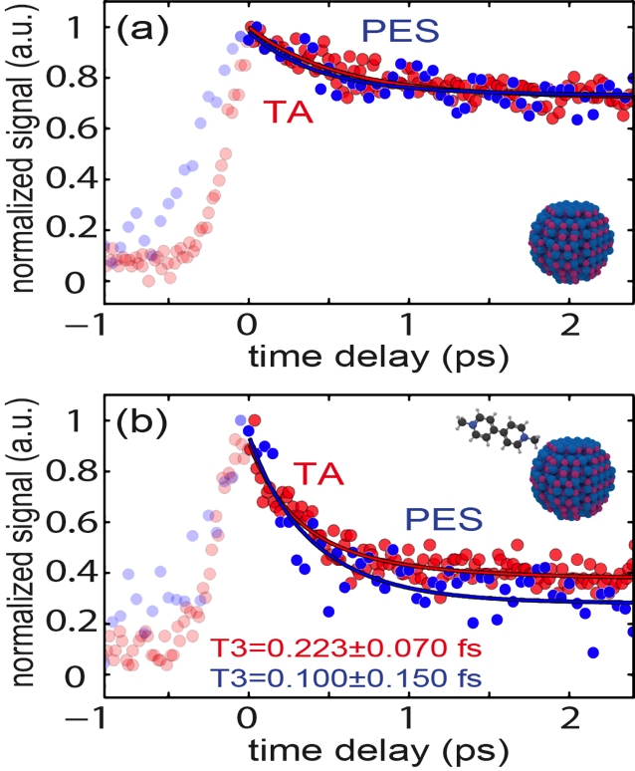
Study 2d Charge transfer in quantum dots
J. L. Ellis, D. D. Hickstein, et al. Solvents Effects on Charge Transfer from Quantum Dots. J. Am. Chem. Soc. 137, 3759 (2015)
Notes:
In addition, we conducted another study where we attached small molecules to the quantum dots that act as electron acceptors and serve a a model charge transfer system with which to understand the type of charge transfer that would take place in photovoltaic devices based on quantum dots. These type of studies are frequently conducted in the solution phase, but using our spectrometer, we were able to study the electron transfer rate in the absence of any solvent. What we found was that the solvent did not affect the charge transfer rate (to the precision of our measurement). This is really good news for people performing charge transfer studies in the solution phase, because it means that the results that they find in solution are likely representative of the behavior of charge transfer in the actual environments where quantum dots are likely to be deployed for devices.

Slide 33
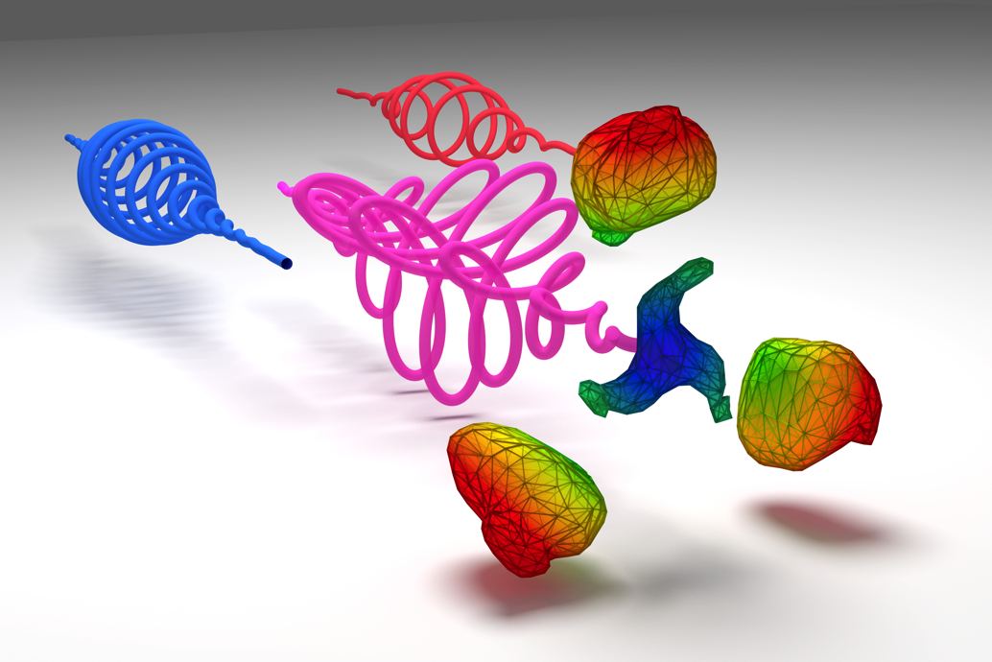
Study 3 SFI in two-pulse circularly polarized fields
C. A. Mancuso; D. D. Hickstein. et al. Strong-field ionization with two-color circularly polarized laser fields. Phys. Rev. A 91, 031402(R) (2015).
Notes:
In this last section of my talk, I’d like to present some very recent results examining strong field ionization and high harmonic generation in circularly polarized laser fields. If you are familiar with high harmonic generation, you might be thinking that I have just said something wrong, because it is a well known fact that you cannot drive the high harmonic generation process with a circularly polarized laser pulse. The circular polarization can still cause electrons to tunnel ionize, but the electrons are driven strongly away from the ion and never return to recombine and produce high harmonics. And this was always a dissapointment, because circularly polarized EUV light is useful for performing spectroscopy on chiral molecules as well as examining the magnetic dichroism in magnetic materials.

Slide 34
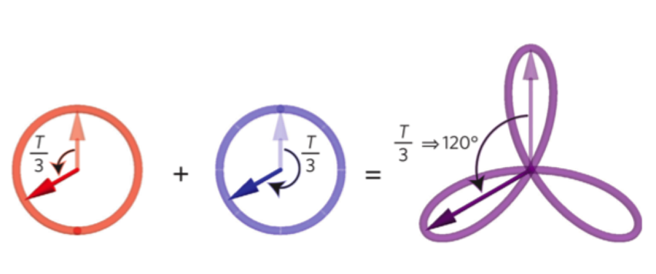

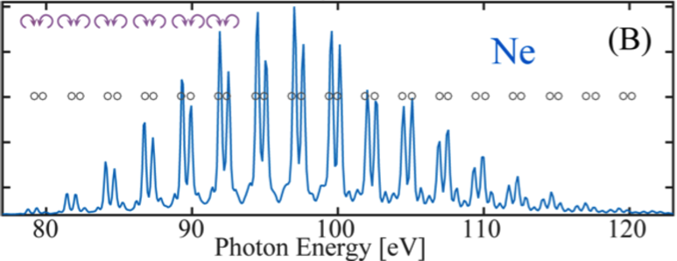
Circularly polarized HHG
ω
(800 nm)
2ω
(400 nm)
Combined field
1. Kfir, O. et al. Generation of bright circularly-polarized extreme ultraviolet high harmonics for magnetic circular dichroism spectroscopy. Nat. Photon. 9, 99–105 (2015).
2. Fleischer, A., Kfir, O., Diskin, T., Sidorenko, P. & Cohen, O. Spin angular momentum and tunable polarization in high-harmonic generation. Nat. Photon. 8, 543–549 (2014).
Notes:
While it is true that harmonics cannot be generated from a single circularly polarized laser pulse, it turns out that if you mix two counter-rotating circularly polarized laser pulses with different frequencies, in this case mixing the fundamental with the second harmonic, then you produce a really strange waveform that can return the electrons to the ion and produce high harmonics. This was discovered last year by Oren Cohen’s group at the Technion in Isreal, and subsequently demonstrated in a high-flux capillary-tube geometry in a collaboration between our group and Oren Cohen’s group.
And this was a really exciting breakthrough, so much so that it was featured on the cover of science last month.
And the explanation for the generation of circularly polarized harmonics was very interesting. The model was that an electron wavepacket was tunnel ionized three times per laser cycle, and these wavepackets were returned to generate an attosecond pulse train where each pulse is roughly linearly polarized, but rotated from the previous pulse by 120 degrees. What you end up with is a comb of high harmonics in pairs. One of the harmonics is left circularly polarized and one harmonic is right circularly polarized. Using magnetic dichroism measurements, we confirmed that the helicity of the harmonics really does flip with each harmonic order.
However, just by looking at the harmonics there was no way to really confirm that this 120-degree symmetry was really at the heart of the process.

Slide 35
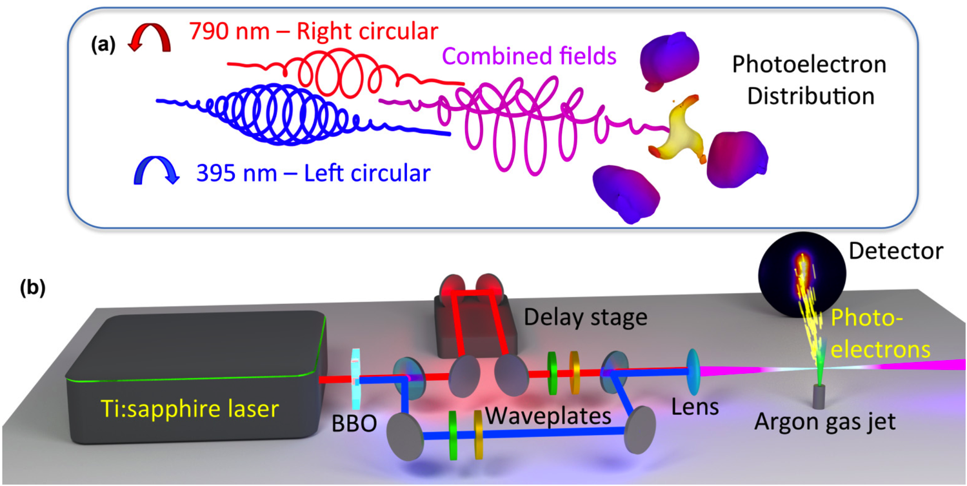
Strong-field ionization in two-color counter-rotating fields
Notes:
So, as we have done before, we turn to strong field ionization in order to provide additional insight into the high harmonic generation process.
And this is what the experiment looks like, we just interfere a left circularly polarized 800 nm pulse with a right circularly polarized laser pulse and record the photoelectron distribution that results. Unfortunately, the experiment is a little bit limited because we need to pass the laser parallel to the detector. This means that the plane of polarization is oriented perpendicular to the detector. So, if we are trying to collect the photoelectron distribution that look like this, we actually only collect a weird projection of that 3D distribution onto the detector.
But, the saving grace is that we can adjust the time delay between the two laser fields. Changing the time delay does not change the shape of the electric field at all, but it does rotate the electric field in the laboratory frame.

Slide 36
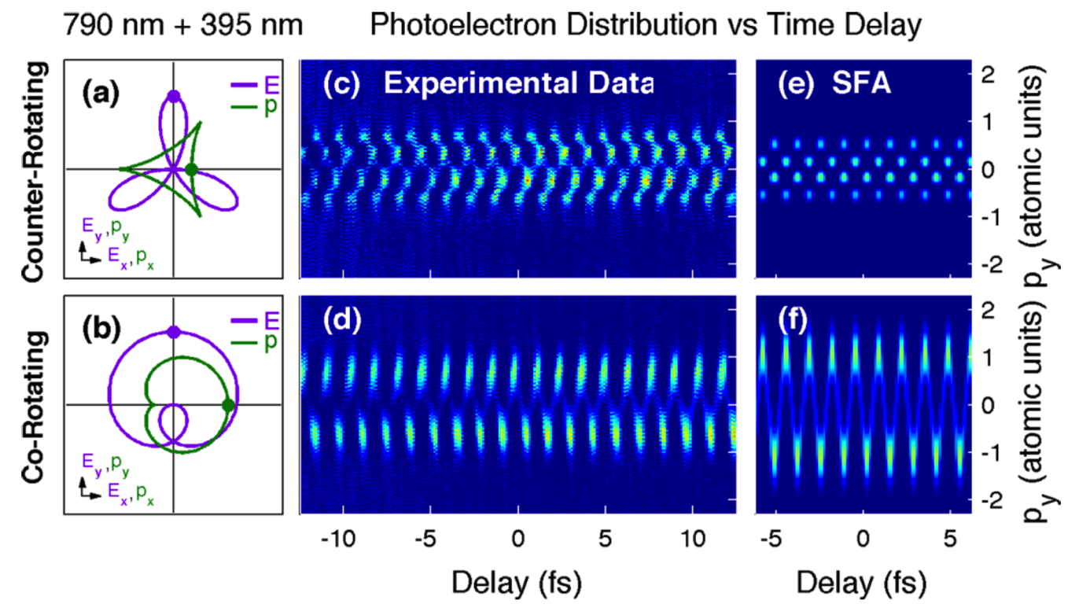
Photoelectron distribution changes with time-delay
Notes:
Here I’m showing just a one-dimensional projection of the photoelectron distribution, and you can see that it fluctuates with the periodicity of one 400 nm cycle. And you can see also that when we switch the fields to be co-rotating, the behavior is completely different. And, to a first approximation, these patterns are exactly what you would expect by applying a simple strong-field approximation model to the generated laser fields.
But, we don’t need to be content with this weird abstraction of the 3D data. We are taking many projections of the 3D photoelectron distribution at different angles, and this is the same thing that is done during an computer assisted tomography x-ray scan at a hospital. We can use the same tomographic reconstruction techniques in order to retreive the full 3D photoelectron momentum distribution from the 2D projections.

Slide 37
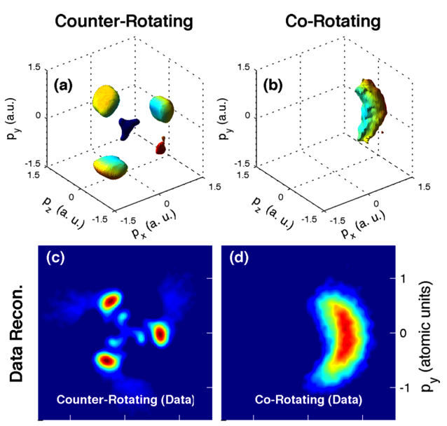
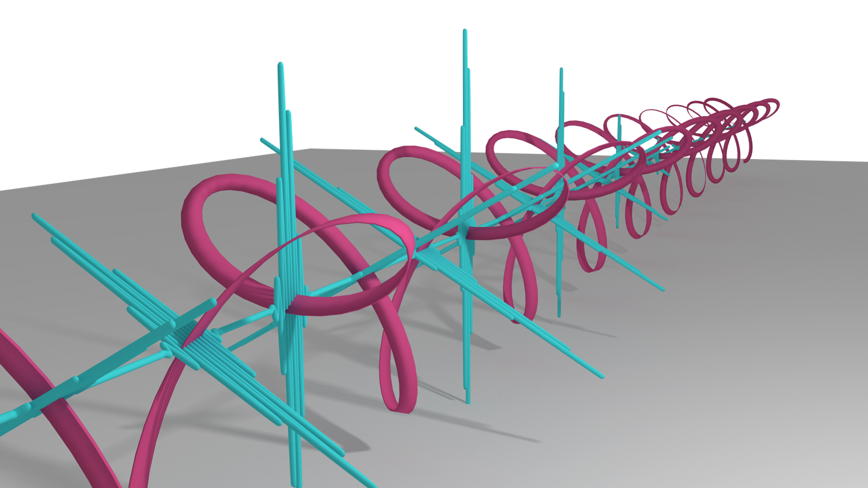
Tomographic reconstructions Confirm mechanism of CP-HHG
Notes:
And this is what the 3D momentum distributions look like. For counter-rotating fields, we have this three-lobed distribution, which correspond to ionization that takes place at the peak of the three different field maxima. When the fields are switched to co-rotating, there is only one broad maximum of the field, and so we just have this crescent shape.
And this confirms the mechanism for the generation of circularly polarized high harmonics and gives us confidence that we are producing this weird pulse train with rotating linearly polarized laser pulses.
Here we look at 2D projections of the 3D momentum distribution, and it makes it a little easier to visualize the features.

Slide 38
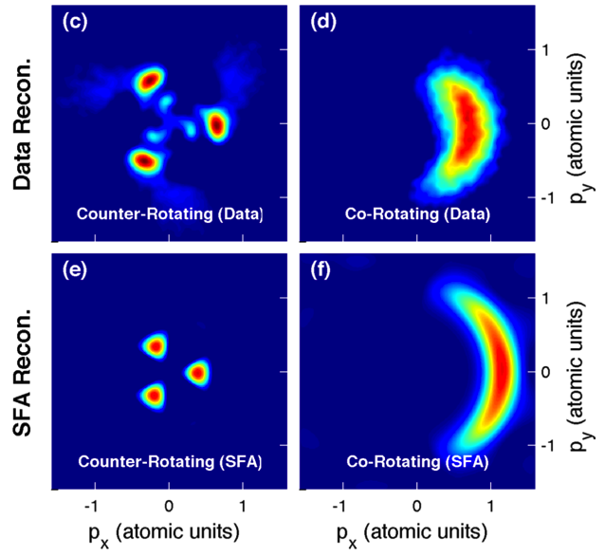
Strong-field approximation Only produces some structures
Notes:
When we compare the experimentally retrieved distributions to what we expect from a strong-field model, we notice that the agreement is generally good, except that the simple model completely fails to reproduce the structures that are seen in the low energy center of the counter-rotating distribution. So, we immediately have an intuition that these features are a result of the Coulomb potential of the ion, which the strong field model does not take into account.

Slide 39
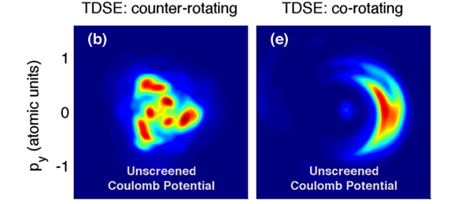
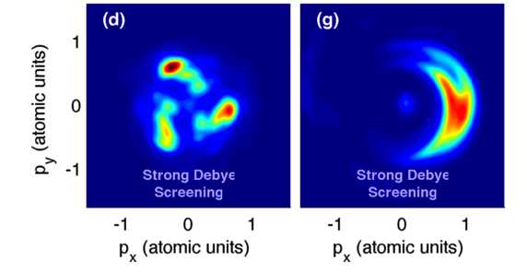
TDSE Reveals role of Coulomb potential
TDSE calculations by Prof. Xiao-Min Tong, Tsukuba University, Japan
Notes:
By turning to higher level calculations using the time dependent schrodinger equation, we can confirm that scattering from the Coulomb potential is responsible for the low energy features in the counter-rotating fields. When the Coulomb potential is screened, we see that there is no change to the distribution generated with co-rotating fields. But, in the distribution with counter-rotating fields, the inner structures almost completely disappear when the Coulomb potential is attenuated.
So, these low energy structures are a direct result of the electron wavepacket scattering from the coulomb potential after tunnel ionization, making it analogous to the spider structures identified for the strong field ionization of atoms.

Slide 40
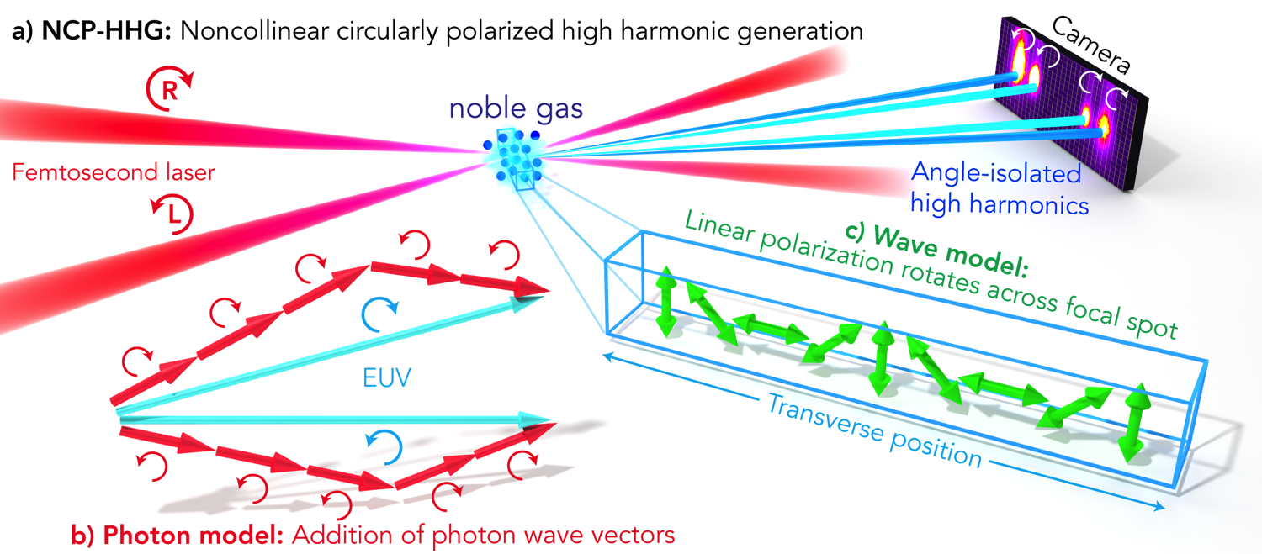
Study 4 Noncollinear circularly polarized HHG
D. D. Hickstein, et al. Noncollinear generation of angularly isolated circularly polarized high harmonics. Nat. Photon. In review.
Notes:
Having confirmed the mechanism of circularly polarized HHG, the next question was if we could improve upon this method. Working with Chip Durfee at Colorado School of Mines, we came up with a new idea for how we could generate circularly polarized high harmonics. The idea was pretty simple. Instead of using two beams with different colors, could we instead cross two counter-rotating circularly polarized beams beams at some small angle. This makes sense in a photon picture: we should be able to absorb so many right circularly polarized photons from one beam, and a similar number of photons from the left circular beam and still obey the selection rules. In the wave picture, at first it seems like the two beams should just mix to yield linear polarization. And this is basically what happens, except that the linear polarization rotates as a function of the transverse position in the laser focus. And this leads to something that look like a grating structure. Then, in the far field, we expect to see diffraction which causes the left and right circularly polarized harmonics to emerge at different angles. In addition, different wavelength harmonics will be emitted to different angles, giving us a way to separate the harmonics without using a spectrometer.

Slide 41

NCP-HHG photon and wave models
Notes:
And this slide compares the case of two linearly polarized beams mixing with two counter-rotating circularly polarized beams mixing. In the linearly polarized case, the only selection rule is that the total number of photons absorbed must be odd. And here I’m showing all of the different photon combinations that result in generating the 7th harmonic. We can draw the same picture for the other harmonics, and the end result is that you have a whole mess or harmonics all on top of one another and being emitted at different angles. And you can see the same thing in the wave picture. Since we have a nonlinear amplitude modulation across the laser focus, then we have many diffracted peaks in the far field.
In contrast, in the case of circularly polarized fields, the conservation of spin angular momentum imposes another selection rule: that the number of photons from one beam must be equal to the number of photons absorbed from the other beam, plus or minus one. So, we end up with just two beams for each harmonic order. One left circularly polarized and one right circularly polarized. In the wave picture we have a polarization that rotates across the laser focus and we get circularly polarized beams.

Slide 42

267 nm Angularly separated harmonics
Notes:
And this is exactly what we see when we use short wavelength driving lasers and look at the low-energy harmonics. Here I’m showing the 5th harmonic of a 267 nm driving laser as seen through an aluminum filter. As you can see, the left circularly polarized beam propagates to the left, and the right ciruclarly polarized beam propagates to the right.
When we use a tin filter, we can also see the lower energy third harmonic, which propagates to the outside of the 5th harmonic and is separated.

Slide 43


800 nm Attosecond pulse trains
Notes:
We can do the same thing using other wavelengths of driving laser, although in this case the different harmonics could not be angularly separated, and so we need to separate them with a grating in the vertical direction. In this case, you can still see that the harmonics emerge to slightly different angles, but they overlap. And the overlap of the harmonics may be considered a good thing, since when you have multiple harmonics overlapping you still end up with the attosecond pulse train that can be useful for some types of pump-probe experiments.

Slide 44

400 nm High flux single harmonic
Notes:
We can do the same thing using 400 nm driving lasers, and when we use Argon as the HHG medium we achieve a high flux of a single harmonic order.

Slide 45

400 + 800 nm Left and right helicity at different harmonic orders
Notes:
And we can use this technique with two beams that are different colors. Here, instead of having both left and right circularly polarized beams at the same frequency, we have left and right beams at different frequencies, which is very similar to the two-beam collinear technique. However, because we have the beams crossing at an angle, the angle that each beam emerges indicates which photons were absorbed to create that beam. So, this 18th harmonic should be forbidden, but due to some ellipticity in the driving lasers, it was able to absorb three extra photons from the left circular beam. And interestingly, even though these beams correspond to slightly elliptical driving lasers, they should still be entirely circularly polarized.

Slide 46

XMCD confirms circularity
Notes:
In order to confirm the circular polarization of each harmonic, as well as to demonstrate that the noncollinear source was bright enough for actual applications, we performed an X-ray magnetic circular dichroism measurement on a 20 nm thick iron sample. Here is the transmission of the harmonics through the sample, and here is the XMCD signal in the regions where we had harmonic flux. To our knowledge, this is the only measurement of the XMCD asymmetry of iron in this photon energy range, but there are some synchrotron measurements are slightly higher photon energies and extrapolating these results indicates that an XMCD asymmetry of about 1.5 percent is expected in this range. So, we can see that our beams are highly elliptical, if not completely circularly polarized.

Slide 47

Future capabilities
Numerical simulations by Carlos Hernandez-Garcia, JILA
Notes:
Numerical simulations demonstrate several additional capabilities of this technique that we have not yet demonstrated experimentally. First, with both 400 and 800 nm light and sufficient pressure in the interaction region, we should be able to separate the harmonics orders. Of course, separated harmonics in the time-domain are long pulses.
Additionally, just like in single-beam HHG, if very short driving laser pulses are used, we can generate isolated attosecond pulses. Importantly, since the pulse trains generated by the noncollinear method exhibit simple circular polarization, in contrast the the weird rotating linear polarization of the collinear generation method, the isolated attosecond pulses will still be circularly polarized.

Slide 48

Spatial profile
Notes:
Here are the spatial profiles of the harmonics generated with 400 nm driving lasers. As you can see, as we make the angle wider, the harmoinc beams become better separated. When we switch to lienar polarization, additional peaks appear on the outside.
Most importantly, here is an image where I have inserted a single hair into the harmonic beams and blocked one of the beams. This may not seem very impressive, but it’s actually very unique in high harmonic generation. Typically, in single beam HHG, you have a very intense laser beam co-propagating with the harmonics. So, if you want to use the harmonic beam while it is still small and before it has time to diverge, you need to contend with a very intense femtosecond beam. If you tried to position a hair in the tightly focused harmonics beam, it would instantly be burned by the optical beam. In our case, we can position a sample just a few mm from the interaction region and use the high intensity harmonic beam without needing to worry about the pump beams, which pass to the side.

Slide 49


Cavity-enhanced HHG
Single pulse: requires output coupler
Two-pulse noncollinear
Jun Ye group, JILA
Notes:
Finally, this separation of the pump beam from the harmonic beam may find applications for high-rep rate cavity enhanced high harmonic generation as well. In current implementations of cavity enhanced HHG, a diffraction grating is used to couple the harmonic light out of the cavity while keeping the driving laser inside the cavity. This is problematic because the diffraction grating does not efficiently reflect the harmonics, and many applications do not want the harmonics to be dispersed before passing through the sample. Other solutions include using a glass plate at Brewster’s angle but this is also very for the harmonics, or drilling a small hole in one of the cavity mirrors so that the harmonics can escape, which introduces more losses in the cavity.
Another option that has been proposed is to use a noncollinear mixing geometry in order to separate the harmonics from the driving beams. I do not know what has been tried along these lines, but this geometry might not work so well with linear polarization, since many beams would be created for each harmonic order, and you would get a fan or harmonics emerging in many directions. In contrast, if you could do this with circular polarization, then this could be achieved with only two output beams, making the high harmonics more useful.

Slide 50

Future directions
Attosecond probes of nanoparticles using HHG
Generation of ultrapure nanoparticles with magnetron sputtering
Extend circularly polarized HHG into the soft X-ray region

Slide 51














Acknowledgements
JILA
University of Colorado Chemistry Department
Brett
Palm
Jose
Jimenez
Gordana
Dukovic
Kyle
Schnitzenbaumer
Livermore National Lab
Naval Research Lab
Dan
Hickstein
Ellen
Keister
Franklin Dollar
Jennifer
Ellis
Wei
Xiong
Jim Gaffney
Steve Libby
George Petrov
Colorado School of Mines
Predrag
Ranitovic
Henry Kapteyn
Margaret Murnane
Chip Durfee
Notes:
To complete these experiments, we needed help from a lot of different, and here is just a partial list of people that I need to thank. Thanks to the team at JILA, especially Jennifer Ellis and Wei Xiong and MARGARET and HENRY. Also thanks to Jose Jimenez and his graduate student Brett Palm. And big thanks to our theory collaborators at Livermore National Lab and Naval Research Lab.

Slide 52

Thank you!
Notes:
So, thank you for your attention, and I would be glad to take any questions or comments.

Slide 53
Thank you!
Notes:
So, thank you for your attention, and I would be glad to take any questions or comments.

Slide 54
Thank you!
Notes:
So, thank you for your attention, and I would be glad to take any questions or comments.

Slide 55


Plane–spherical wave model
Notes:
And we were actually able to help confirm this explanation by implementing a very simple model that could quantitatively predict the shape of the spider structures from first principles. All we did was to model the ionized electron wavepacket just as we could model an ocean wave hitting a rock: as a superposition of the plane wave, which does not scatter from the coulomb potential, and the spherical wave, which is the scattered portion.
With this model, we can generate interference structures that look very much like the spider structures. Here I have overlayed the minima of the spider structure, as predicted by a calculation with the plane-spherical wave model on the actual data, and, as you can see, the shape is a very good fit.
The spacing of the spider structure calculated using the plane-spherical wave model depends on the frequency of the plane and spherical waves. And you might think that I just picked this frequency so that I would get a good agreement with the experimental data. But this is not the case! The frequency of the the plane and spherical waves can be calculated from first principles, given the intensity and wavelength of the laser.

Slide 56
Plane-spherical wave model
Notes:
As you can see here, we can use this very simple plane-spherical wave model to simulate what the electron distributions should look like at these different wavelengths and intensities. The correspondence is not perfect, but I have drawn the minima on the lower graph, and you can see that they match up really well with the data with the three longest wavelengths.

Slide 57
Numerical rescattering

Slide 58


Magnetron nanoparticle source Attosecond studies of pure, isolated nanoparticles
Notes:
The next step that we are going to take is to switch to generating our nanoparticles through a magnetron sputtering source, which will allow us to generate ultrapure, very small nanoparticles of metal and semi-conductor materials.

Slide 59




Time dependence
Notes:
So, we looked at how the total photoion yield changed as a function of the time-delay between a 400 nm and an 800 nm laser pulse. By using an 800 and 400 nm laser pulses, we are able to create a large enhancement in the total photoion yield then the 400 nm pulse precedes the 800 nm pulse by about 2 to 30 femtoseconds.
This effect has been seen before in nanoscale silver clusters and it was explained very simply. The first pulse creates a nanoplasma which expands. As the nanoplasma expands, it becomes more larger therefore more absorbing of the second laser pulse. However, as the nanoplasma becomes too large, it’s density drops below the critical density and it can no longer effectively absorb energy from the laser pulse.
So, this is a nice result, but we see something even more interesting if we look at the photoion angular distributions that correspond to these red dots.

Slide 60

Time dependence
Notes:
So, we looked at how the total photoion yield changed as a function of the time-delay between a 400 nm and an 800 nm laser pulse. By using an 800 and 400 nm laser pulses, we are able to create a large enhancement in the total photoion yield then the 400 nm pulse precedes the 800 nm pulse by about 2 to 30 femtoseconds.
This effect has been seen before in nanoscale silver clusters and it was explained very simply. The first pulse creates a nanoplasma which expands. As the nanoplasma expands, it becomes more larger therefore more absorbing of the second laser pulse. However, as the nanoplasma becomes too large, it’s density drops below the critical density and it can no longer effectively absorb energy from the laser pulse.
So, this is a nice result, but we see something even more interesting if we look at the photoion angular distributions that correspond to these red dots.
The red dots indicate which frames contain these sharp rings. So, we see that the appearance and disappearance of the rings corresponds very closely to the peak in the ion yield. This indicates that the shock waves are also linked to the expansion of the nanoplasma. This is exactly the behavior predicted by the theory papers. Several of them explicitly mentioned that using a first laser pulse to pre-expand the plasma and having a second pulse generate the shock wave would be the ideal situation for creating strong shock waves in nanoplasmas.

Slide 61

Hydrodynamic simulations
Calculations by Jim Gaffney, LLNL
Notes:
This explanation is confirmed with hydrodynamic simulations completed by our collaborators at Lawrence Livermore National Lab. This plot has some fun colors, but it’s not a cartoon, it’s the actual results from the numerical simulations.
The first three frames plot the density of the plasma versus the radial coordinate. Immediately after the first laser pulse, the plasma density is just a step function corresponding to the solid density nanoparticle. After about 20 picoseconds, the plasma has expanded and now assumes this smooth decay into the vacuum. Because of this decaying density profile, when the second laser pulse arrives, it is absorbed in a thin layer near the critical density. This localized absorption creates a pressure wave that propagates inwards. The pressure wave reflects from the center and moves outwards. As the pressure wave moves outwards. It steepens into a shock wave. The shock wave may look pretty puny when plotted in the density distribution, but when we look at the kinetic energy distribution of the ions, which is what we actually see on the detector, then the shock wave manifests as an obvious sharp peak, in good agreement with the experiment.

Slide 62

PEI Electrons

Slide 63

PEI Centers of mass

Slide 64
Single KI nanoparticle Mass Spectrum

Slide 65


Slide 66

Synchrotron XMCD asymmetry

